Slide 1


Why Would a Data Scientist Use Seaborn?
OIM 7502 Spring 2025 – Midterm Project
Karen Alderete Romo

Slide 2

What is Seaborn?
Python data visualization library based on matplotlib
Provides a high-level interface for attractive and informative statistical graphics
Built specifically for data science and analytics
Based on this 4 primarily libraries: numpy, pandas, matplotlib, scipy
WHY USE IT?
Integrates seamlessly with pandas Data Frames
Simple syntax for complex visualizations
Excellent for Exploratory Data Analysis (EDA) and data storytelling
Visually appealing default styles
Built-in Datasets useful for practice and demos; easily loaded (e.g., tips, flights)
Statistical plots like boxplots, histograms, heatmaps, and regression lines

Slide 3
MAIN CATEGORIES OF SEABORN PLOTS
Categorical
Countplot
Barplot
Distribution
Displot
Joinplot
Boxplot
Violinplot
Stripplot
Swarmplot
Factorplot
Relational
Regression
Matrix
Multi-plot grids
Pairplot
Rugplot
Heatmap
Cluster map
Simple linear plot
Linear plot + additional parameters
Size and color of the plot
Display multiple plots
Size and aspect ratio of the plots

Slide 4
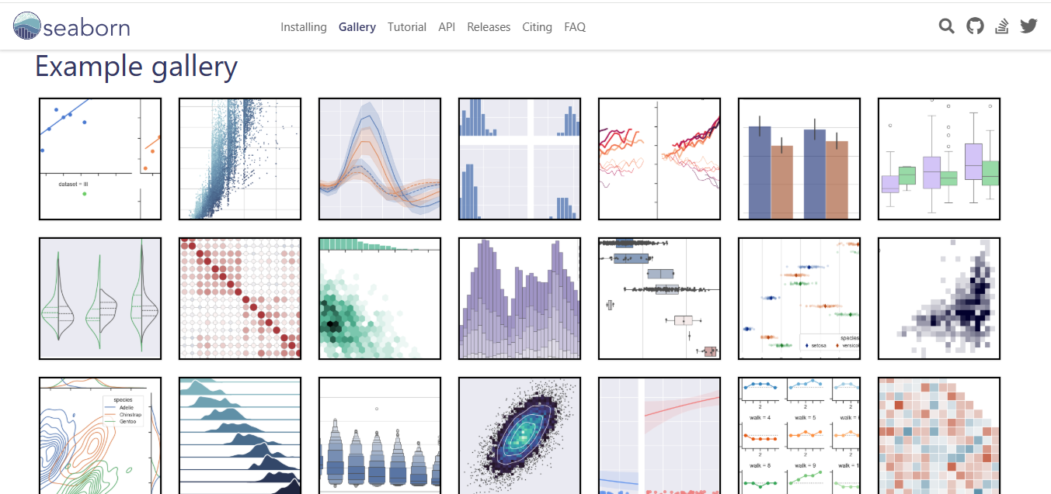
WHAT YOU CAN CREATE

Slide 5
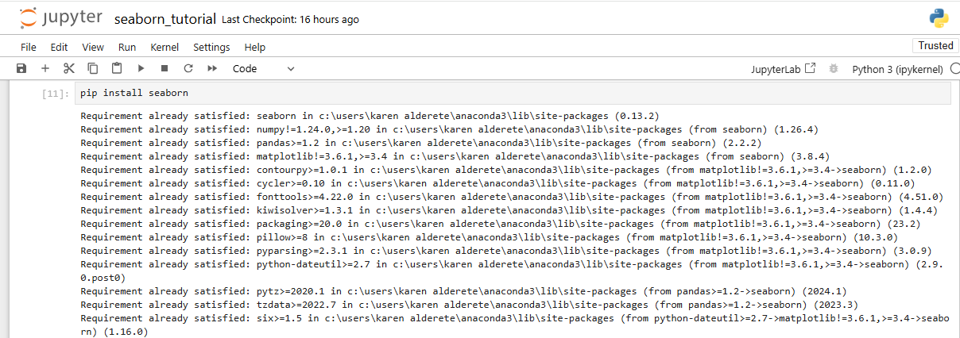
Let’s start!
1. Installation*
*Make sure you have Python installed. The library is also included as part of the Anaconda distribution, and it can be installed with conda → conda install seaborn
For interactive work, it’s recommended to use a Jupyter/IPython interface in matplotlib mode

Slide 6
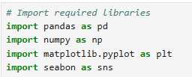
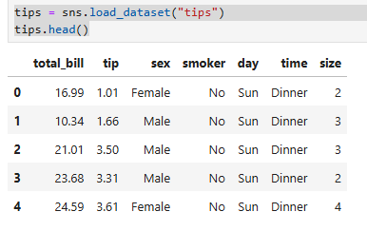

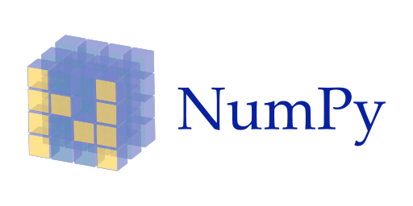

2. Import required libraries
3. Load a sample dataset (e.g., tips dataset)
Remember Seaborn comes with built-in datasets!
IMPORTANT INFORMATION
Supported Python versions: Python 3.8+
Mandatory dependencies:
Optional dependencies:
→ statsmodels (for advanced regression plots)
→ scipy (for clustering matrices + some advanced options)
→ fastcluster (for faster clustering of large matrices)

Slide 7
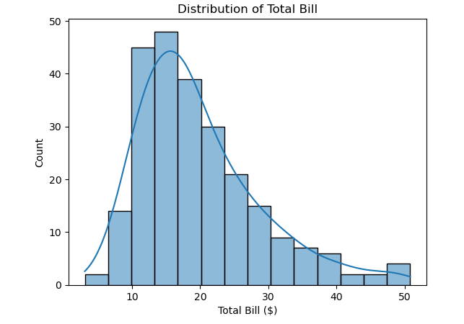
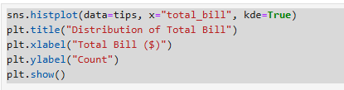
Example basic plot: histogram with kde
Distribution of total_bill to see how the data is spread out + Kernel Density Estimate (KDE) curve (blue line) to better understand the shape of the distribution.
INTEPRETATION
The majority of total bills fall between $10 and $20, with a peak around $15
The distribution is right-skewed, meaning: Most bills are on the lower end
A few higher bills (above $30) occur less frequently but stretch the tail to the right
This skewness suggests that while small-to-mid-size bills are common, large total bills are rare but present

Slide 8
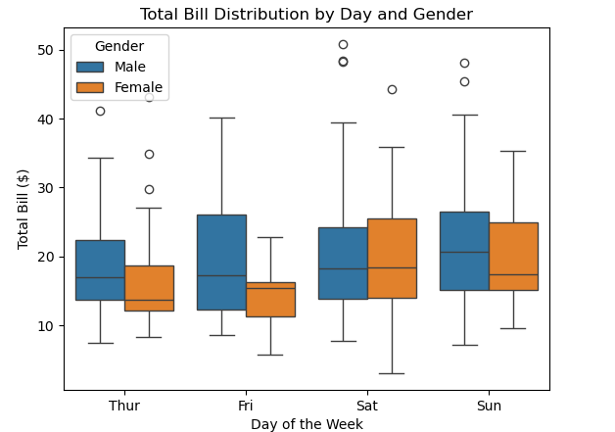
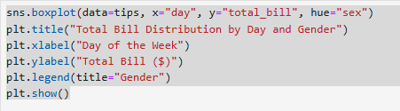

Example CATEGORICAL plot: BOX PLOT
Great for comparing distributions across categorical groups
INTEPRETATION
Median total bills (center lines of the boxes) are fairly consistent across days, with Saturday and Sunday showing slightly higher medians for both genders
Overall, males exhibit greater spending variability, while females show more consistent billing patterns across all days
Total bill amounts tend to be higher on weekends, Saturday has the highest spread and several large bills, suggesting it's a peak day for larger dining expenses
with Saturday showing the widest range and most outliers—especially among male customers

Slide 9
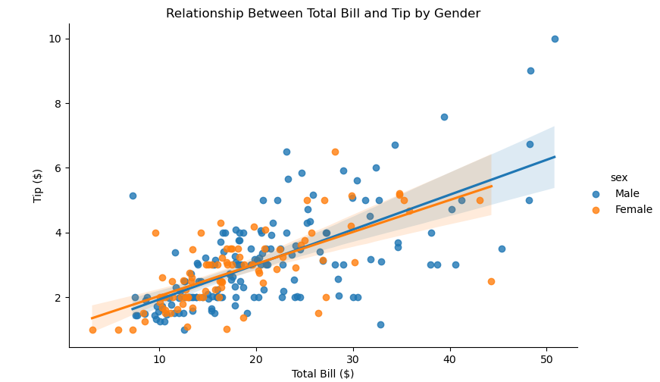
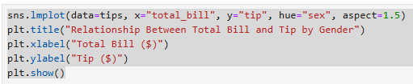
Example RELATIONAL plot: SCATTERPLOT WITH REGRESSION LINE
To visualize the relationship between two numeric variables. We can add a regression line to see general trends with sns.lmplot()
INTEPRETATION
The confidence band (shaded area) overlaps quite a bit, meaning the difference between genders might not be statistically significant
Tips increase with total bill amount for both genders (positive trend), but males tend to tip slightly more for higher bills

Slide 10
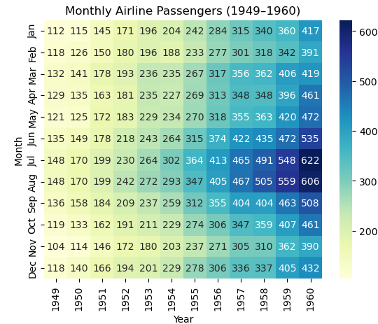
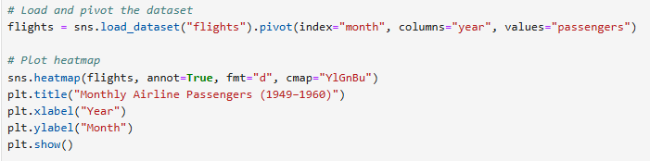
Example ADVANCED plot: HEATMAP
To visualize relationships between two categorical variables (like time and place) with a third variable represented by color intensity
INTEPRETATION
Number of airline passengers per month (1949 to 1960)
Passenger numbers steadily increased across the years, especially from 1955 onward (industry growth)
Clear seasonal pattern: Peak months are July and August (darker blues)

Slide 11
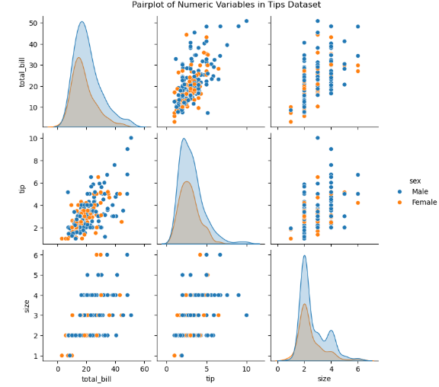

BONUS
Example PAIRPLOT:
Exploring Relationships Across Multiple Variables
Grid of scatterplots and histograms to show pairwise relationship between all numeric variables in a dataset.
It’s ideal for identifying trends, correlations, and clusters at a glance.
INTEPRETATION
Relationships between total_bill, tip, and size, colored by gender
There’s a clear positive correlation between total bill and tip
Most parties are 2–3 people in size, and distributions are slightly right-skewed
Using hue="sex" helps reveal subtle differences between male and female tipping behavior

Slide 12
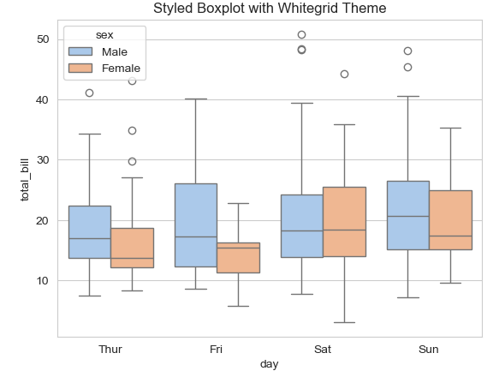
STYLING WITH THEMES
Seaborn allows us to change the style of our plots with just one line of code.
Very useful for making charts presentation-ready or matching a specific visual aesthetic
There are options like:
"darkgrid" (default)
"whitegrid" (great for presentations)
"white" (clean look)
"dark" (good for dark backgrounds)
"ticks" (subtle axis ticks)
*This example uses Seaborn’s whitegrid theme and pastel palette for better readability

Slide 13

Which Should You Use? Seaborn or Matplotlib
FEATURE | SEABORN | MATPLOTLIB
Syntax | High-level | Low-level (manual, step-by-step)
Data Support | Pandas-native | Requires manual handling of arrays
Aesthetics | Built-in themes | Manual styling required
Statistical Plots | Built-in | Need to code manually or customize
CONS OF SEABORN
Less customizable than Matplotlib
Not interactive: Plots are static
Great for EDA, but not ideal for dashboards or real-time visualizations
Limited plot types: Doesn’t support things like 3D plots, maps, or advanced animations.
Relies on Matplotlib backend: You might need to mix in Matplotlib code for advanced layout tweaks
Since it is built on top of Matplotlib, any limitations of Matplotlib (such as verbose syntax for advanced customizations) also apply to Seaborn
Performance issues with large datasets: Not optimized for performance or scalability. It can be slow and memory-intensive

Slide 14

Real-world Use Cases in Data Science
Exploratory Data Analysis (EDA) Before Modeling
Marketing Analytics
Financial Data Analysis
Feature Engineering
Time-Series Analysis
Seasonality Checks
Correlation & Multicollinearity Checks
[…]

Slide 15
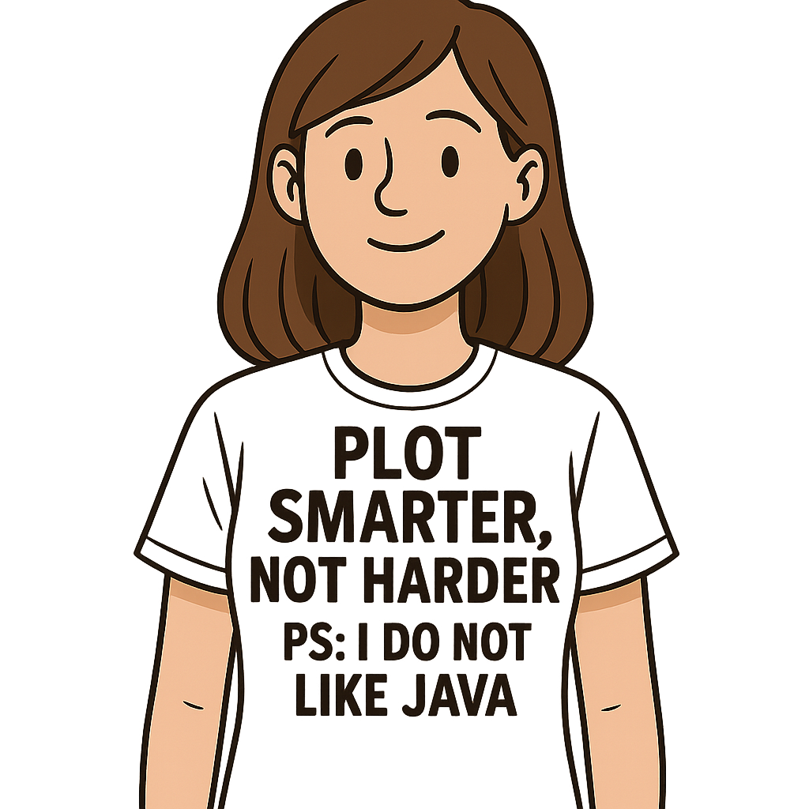
Key Takeaways:
Seaborn is a high-level, user-friendly data visualization library built on Matplotlib
Ideal for EDA, especially with pandas DataFrames
Offers built-in support for statistical plots like boxplots, KDE, and heatmaps
Delivers polished visuals with just a few lines of code using themes and palettes
Saves time and simplifies plotting, letting data scientists focus on insights, not styling
Widely used in real-world data workflows for feature engineering, correlation analysis, and communicating insights
Sources
https://seaborn.pydata.org/index.html
https://seaborn.pydata.org/tutorial/introduction.html
PEP-8 Guide
https://www.youtube.com/watch?v=kjkvfsrDuvA&list=PL4GjoPPG4VqOAwSNw2I-PXUcjw1frHmW2
https://neuraldatascience.io/4-viz/seaborn.html

